Slide 1

ONLINE CLASS
GRAPH THEORY
BICTE $6^{TH}$ SEMESTER
2078/03/16
PRESENTED BY KALYAN DAHAL

Slide 2
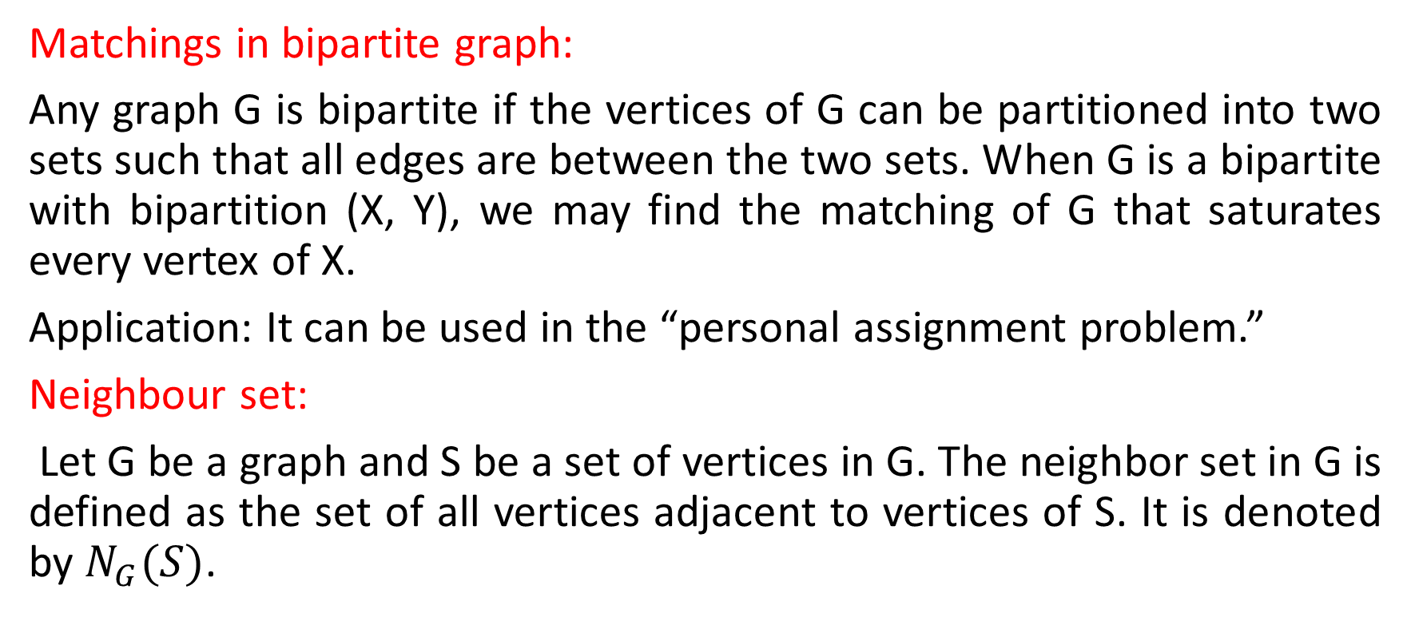
Matchings in bipartite graph
Matchings in bipartite graph:
Any graph G is bipartite if the vertices of G can be partitioned into two sets such that all edges are between the two sets. When G is a bipartite with bipartition (X, Y), we may find the matching of G that saturates every vertex of X.
Application: It can be used in the “personal assignment problem.”
Neighbour set:
Let G be a graph and S be a set of vertices in G. The neighbor set in G is defined as the set of all vertices adjacent to vertices of S. It is denoted by $N_{G}(S)$.

Slide 3
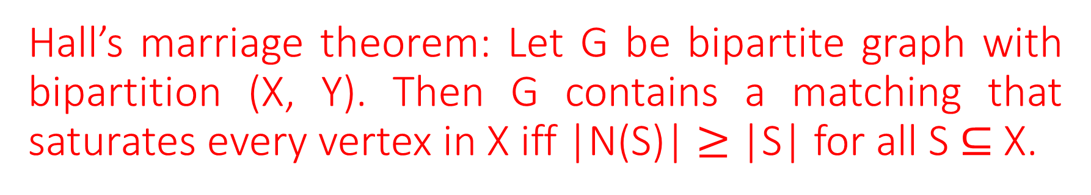
Hall’s marriage theorem: Let G be bipartite graph with bipartition (X, Y). Then G contains a matching that saturates every vertex in X iff |N(S)| $≥$ |S| for all S $⊆$ X.
Proof: we assume that some matching M saturates every vertex of X, and for all S ⊆ X. Let M(s) denote the set of all vertices in Y matched by M to a given S. By definition of a matching, |M(S)| = |S |. But M(S) ⊆ N(S), since all elements of M(S) are neighbours of S. So, |N(S)| ≥ |M(S)| and hence, |N(S)| ≥ |S|.
Conversely, let there is no X-perfect matching and |N(S)| ≥ |S| at least one S ⊆ X. Let M be a maximum matching, and let u be a vertex of X not saturated by M. Consider all alternating paths (i.e., paths in G alternately using edges outside and inside M) starting from u. Let the set of all points in Y connected to u by these alternating paths be Z,

Slide 4
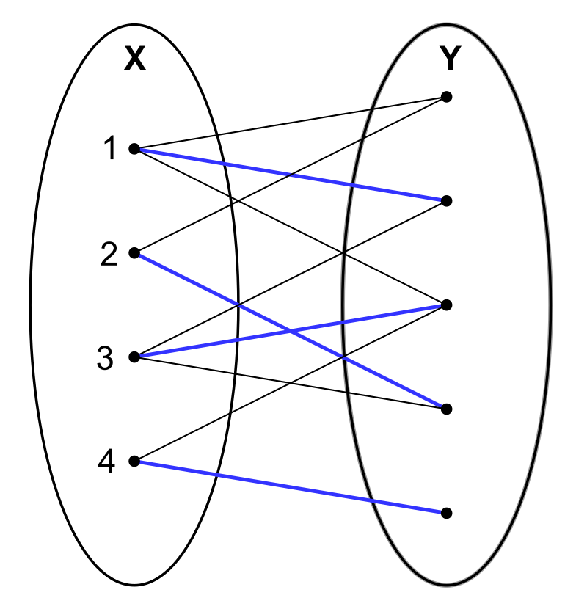
Continued….
and the set of all points in X connected to u by these alternating paths including u itself be S. No maximal alternating path can end in a vertex in Y, then it would be an augmenting path, so that we could augment M to a strictly larger matching by toggling the status (belongs to M or not) of all the edges of the path. Thus every vertex in Z is matched by M

Slide 5
Continued…
to a vertex in S \ {u}. every vertex v in S \ {u} is matched by M to a vertex in Z (namely, the vertex preceding v on an alternating path ending at v). Thus, M provides a bijection of S \ {u} and Z, which implies |S| = |Z| + 1. On the other hand, N(S) ⊆ Z: let v in Y be connected to a vertex w in S. The edge (w,v) must be in M, otherwise u reaches w via an alternating path not containing v, and we could take this alternating path ending in w and extend it with v, getting an augmenting path (which would again contradict the maximality of M). Hence v must be in Z, and so |N(S)| ≤ |Z| = |S| − 1 < |S| which is contradiction. This completes the proof of the theorem.

Slide 6
In a bipartite graph G the number of edges in a maximum matching M is a equal to the number of vertices in a minimum covering C.
Proof: The following proof provides a way of constructing a minimum vertex cover from a maximum matching. Let G=(V,E) be a bipartite graph and let L,R be the two parts of the vertex set V. Suppose that M is a maximum matching for G. No vertex in a vertex cover can cover more than one edge of M (because the edge half-overlap would prevent M from being a matching in the first place), so if a vertex cover with |M| vertices can be constructed, it must be a minimum cover. to construct such a cover, let U be the set of unmatched vertices in L (possibly empty), and let Z be the set of vertices that are either in U or

Slide 7
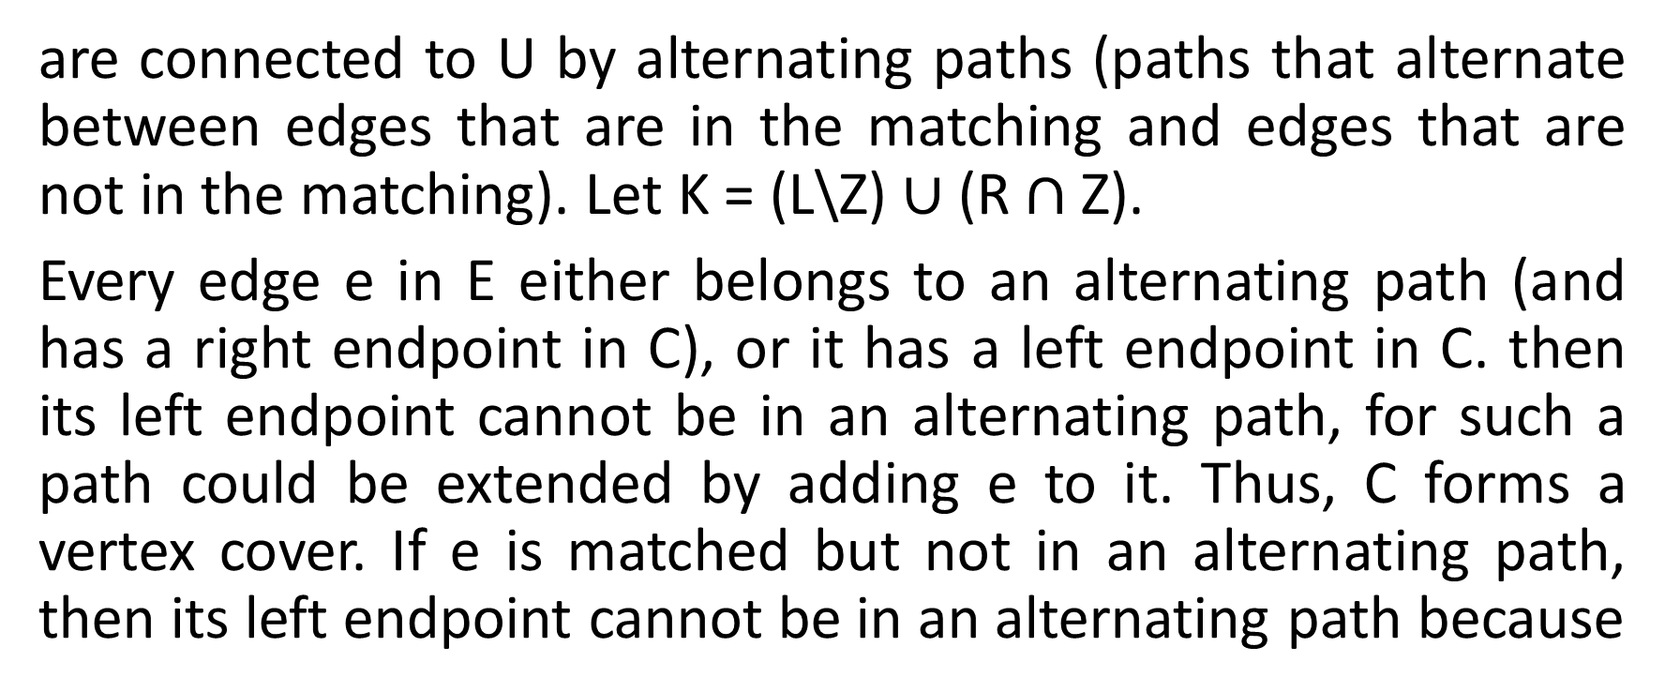
Continued……
are connected to U by alternating paths (paths that alternate between edges that are in the matching and edges that are not in the matching). Let K = (L\Z) $∪$ (R $∩$ Z).
Every edge e in E either belongs to an alternating path (and has a right endpoint in C), or it has a left endpoint in C. then its left endpoint cannot be in an alternating path, for such a path could be extended by adding e to it. Thus, C forms a vertex cover. If e is matched but not in an alternating path, then its left endpoint cannot be in an alternating path because

Slide 8
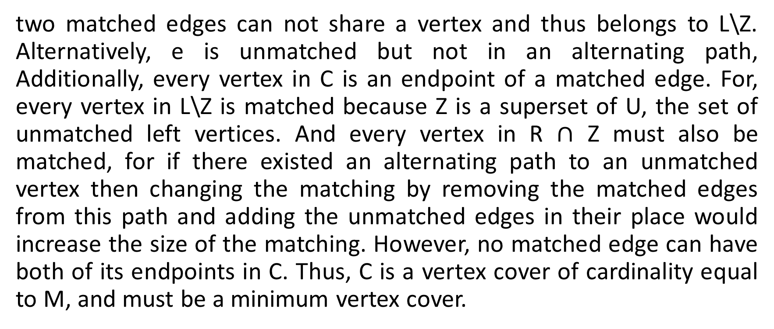
Continued……
two matched edges can not share a vertex and thus belongs to L\Z. Alternatively, e is unmatched but not in an alternating path, Additionally, every vertex in C is an endpoint of a matched edge. For, every vertex in L\Z is matched because Z is a superset of U, the set of unmatched left vertices. And every vertex in R $∩$ Z must also be matched, for if there existed an alternating path to an unmatched vertex then changing the matching by removing the matched edges from this path and adding the unmatched edges in their place would increase the size of the matching. However, no matched edge can have both of its endpoints in C. Thus, C is a vertex cover of cardinality equal to M, and must be a minimum vertex cover.

Slide 9
M-alternating path and M-augmenting path
M-alternating path:
Let G be a graph such that G = (V, E) and M is its matching. A path P in G is said to be an M-alternating path if its edges are alternatively in E – M and M.
M-augmenting path:
An M-augmenting path is defined as an m-alternating path whose origin and terminus are both M-unsaturated.

Slide 10
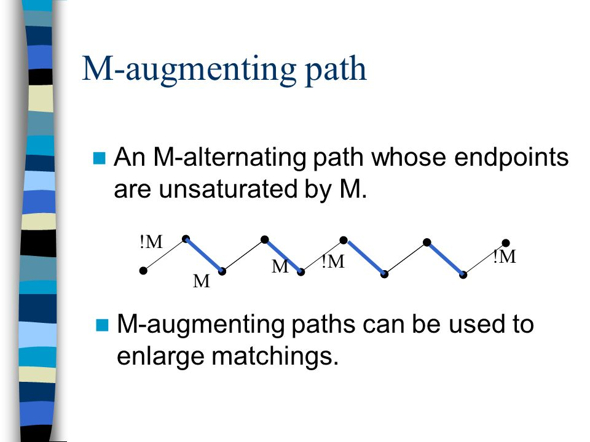
Continued…

Slide 11
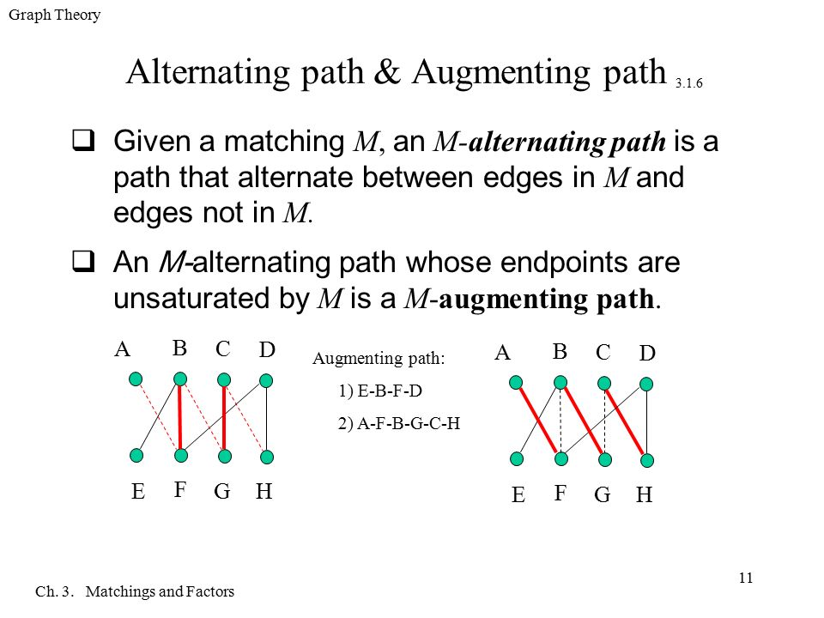
Continued….

Slide 12
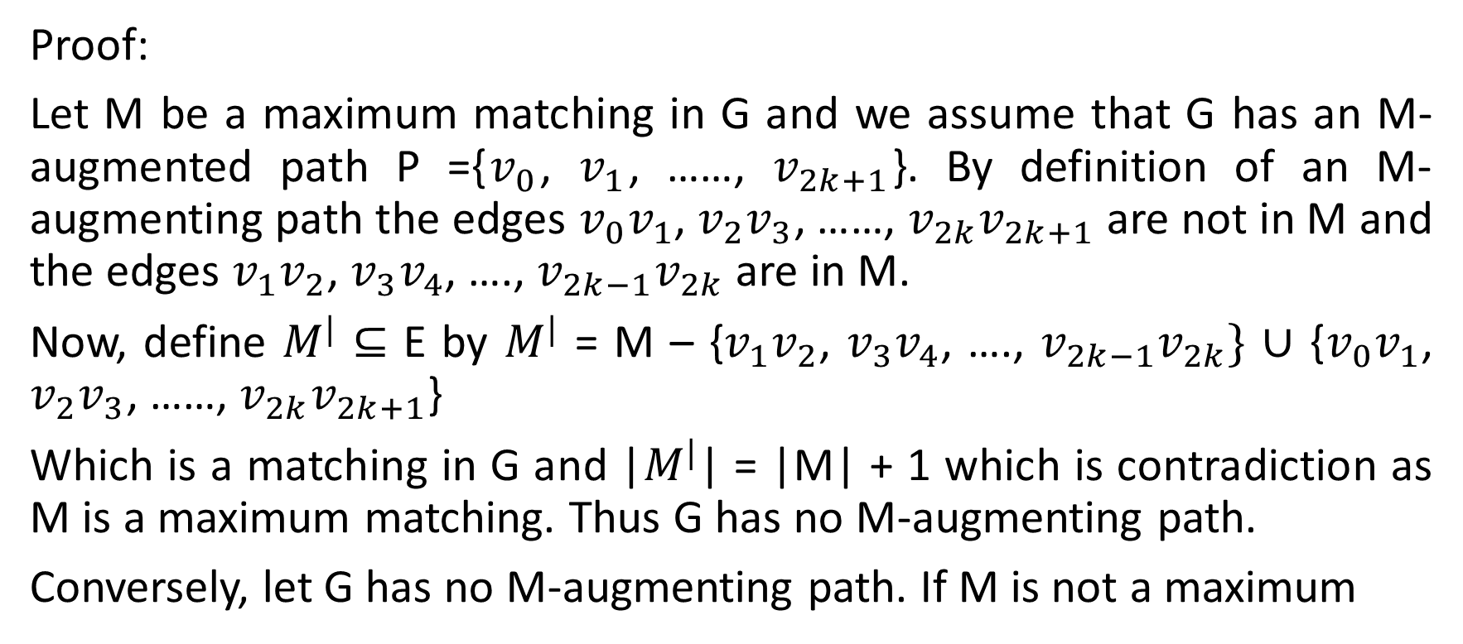
A matching M in a graph G is a maximum matching iff G contains no M-augmenting path.
Proof:
Let M be a maximum matching in G and we assume that G has an M-augmented path P ={$v_{0}$, $v_{1}$, ……, $v_{2k+1}$}. By definition of an M-augmenting path the edges $v_{0}v_{1}$, $v_{2}v_{3}$, ……, $v_{2k}v_{2k+1}$ are not in M and the edges $v_{1}v_{2}$, $v_{3}v_{4}$, …., $v_{2k−1}v_{2k}$ are in M.
Now, define $M^{|}$ $⊆$ E by $M^{|}$ = M – {$v_{1}v_{2}$, $v_{3}v_{4}$, …., $v_{2k−1}v_{2k}\}$ $∪$ {$v_{0}v_{1}$, $v_{2}v_{3}$, ……, $v_{2k}v_{2k+1}$}
Which is a matching in G and |$M^{|}$| = |M| + 1 which is contradiction as M is a maximum matching. Thus G has no M-augmenting path.
Conversely, let G has no M-augmenting path. If M is not a maximum

Slide 13
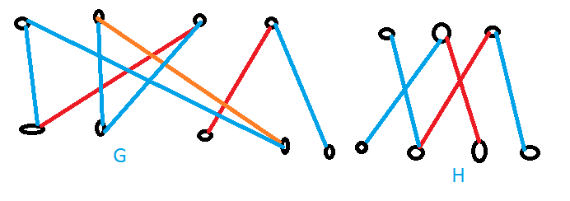
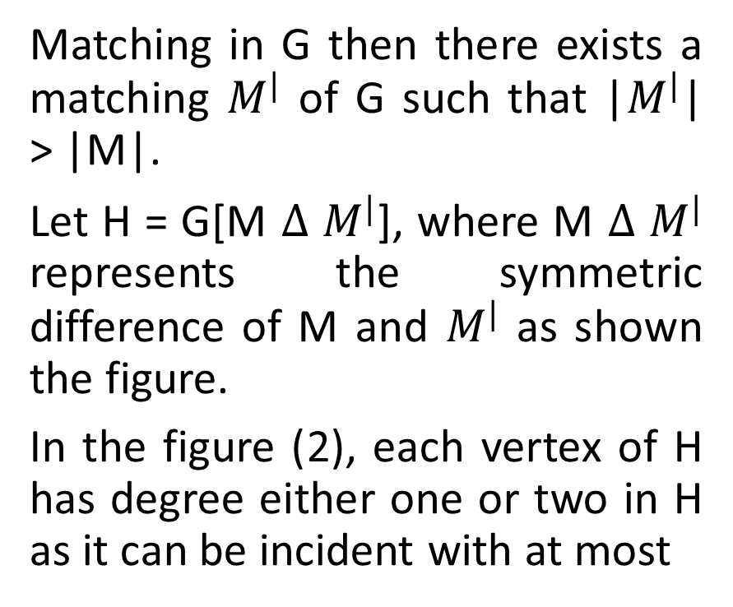
Continued……
Matching in G then there exists a matching $M^{|}$ of G such that |$M^{|}$| > |M|.
Let H = G[M $∆$ $M^{|}$], where M $∆$ $M^{|}$ represents the symmetric difference of M and $M^{|}$ as shown the figure.
In the figure (2), each vertex of H has degree either one or two in H as it can be incident with at most

Slide 14
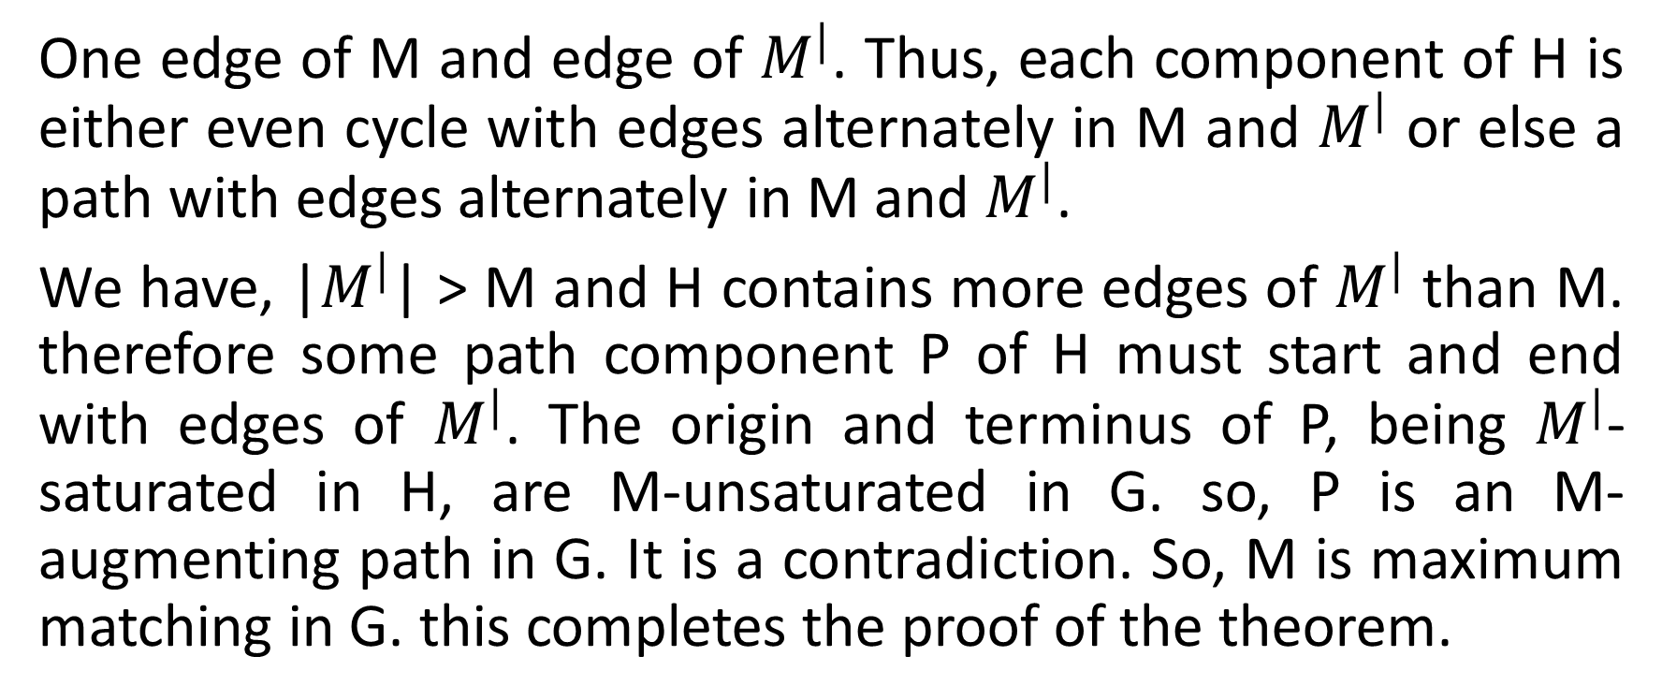
Continued……
One edge of M and edge of $M^{|}$. Thus, each component of H is either even cycle with edges alternately in M and $M^{|}$ or else a path with edges alternately in M and $M^{|}$.
We have, |$M^{|}$| > M and H contains more edges of $M^{|}$ than M. therefore some path component P of H must start and end with edges of $M^{|}$. The origin and terminus of P, being $M^{|}$-saturated in H, are M-unsaturated in G. so, P is an M-augmenting path in G. It is a contradiction. So, M is maximum matching in G. this completes the proof of the theorem.

Slide 15
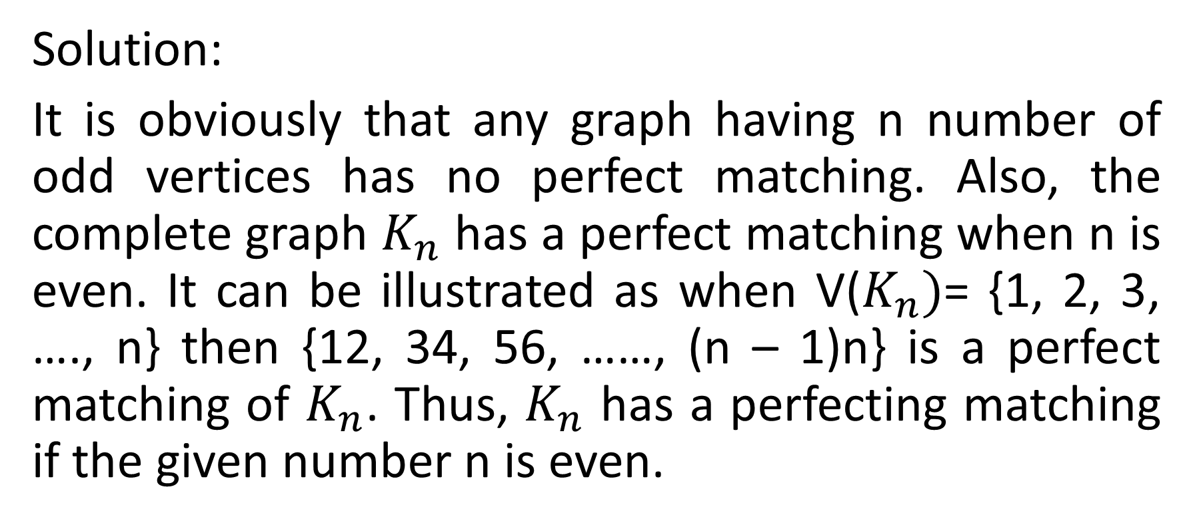

For what values of n does the complete graph $K_{n}$ have perfect matching?
Solution:
It is obviously that any graph having n number of odd vertices has no perfect matching. Also, the complete graph $K_{n}$ has a perfect matching when n is even. It can be illustrated as when V($K_{n})$= {1, 2, 3, …., n} then {12, 34, 56, ……, (n – 1)n} is a perfect matching of $K_{n}$. Thus, $K_{n}$ has a perfecting matching if the given number n is even.

Slide 16
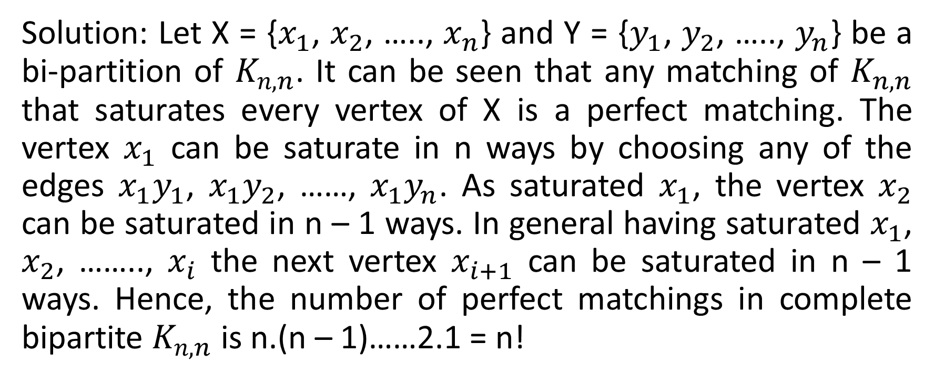

Find the number of perfect matching in the complete bipartite graph $K_{n, n}$.
Solution: Let X = {$x_{1}$, $x_{2}$, ….., $x_{n}$} and Y = {$y_{1}$, $y_{2}$, ….., $y_{n}$} be a bi-partition of $K_{n, n}$. It can be seen that any matching of $K_{n, n}$ that saturates every vertex of X is a perfect matching. The vertex $x_{1}$ can be saturate in n ways by choosing any of the edges $x_{1}y_{1}$, $x_{1}y_{2}$, ……, $x_{1}y_{n}$. As saturated $x_{1}$, the vertex $x_{2}$ can be saturated in n – 1 ways. In general having saturated $x_{1}$, $x_{2}$, …….., $x_{i}$ the next vertex $x_{i+1}$ can be saturated in n – 1 ways. Hence, the number of perfect matchings in complete bipartite $K_{n, n}$ is n.(n – 1)……2.1 = n!

Slide 17
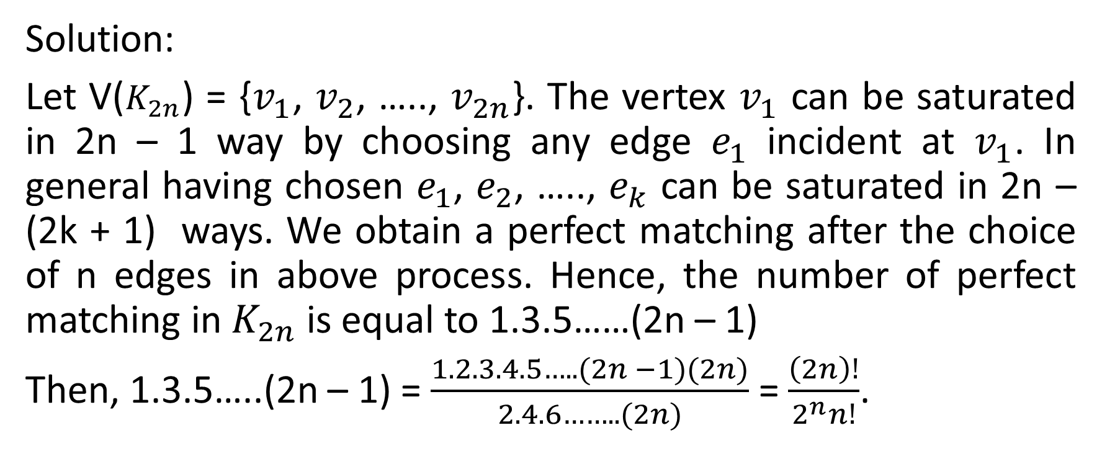

Find the number of perfect matching in the complete graph $K_{2n}$.
Solution:
Let V($K_{2n}$) = {$v_{1}$, $v_{2}$, ….., $v_{2n}$}. The vertex $v_{1}$ can be saturated in 2n – 1 way by choosing any edge $e_{1}$ incident at $v_{1}$. In general having chosen $e_{1}$, $e_{2}$, ….., $e_{k}$ can be saturated in 2n – (2k + 1) ways. We obtain a perfect matching after the choice of n edges in above process. Hence, the number of perfect matching in $K_{2n}$ is equal to 1.3.5……(2n – 1)
Then, 1.3.5…..(2n – 1) = $\frac{1.2.3.4.5…..(2n −1)(2n)}{2.4.6……..(2n)}$ = $\frac{\left(2n\right)!}{2^{n}n!}$.

Slide 18
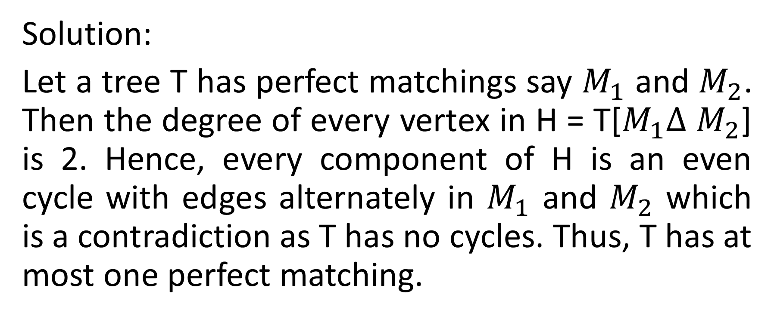
Show that a tree has at most one perfect matching.
Solution:
Let a tree T has perfect matchings say $M_{1}$ and $M_{2}$. Then the degree of every vertex in H = T[$M_{1}∆$ $M_{2}$] is 2. Hence, every component of H is an even cycle with edges alternately in $M_{1}$ and $M_{2}$ which is a contradiction as T has no cycles. Thus, T has at most one perfect matching.

Slide 19


